Slide 1
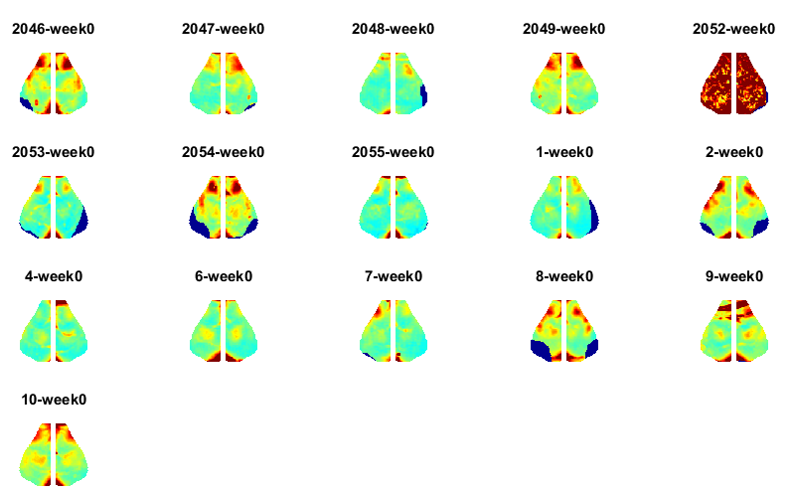
Week 0 Young Delta

Slide 2
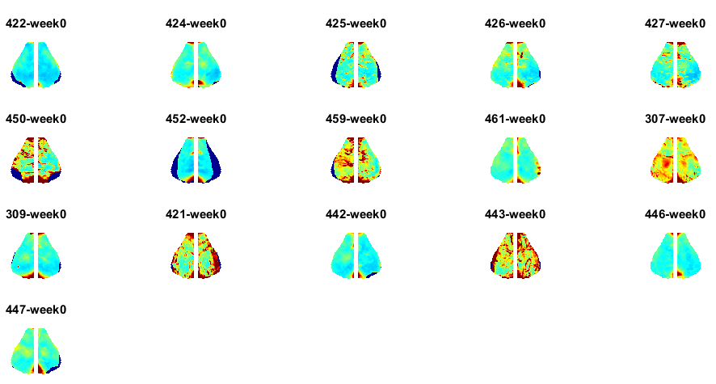

Week 0 Aged Delta
578

Slide 3
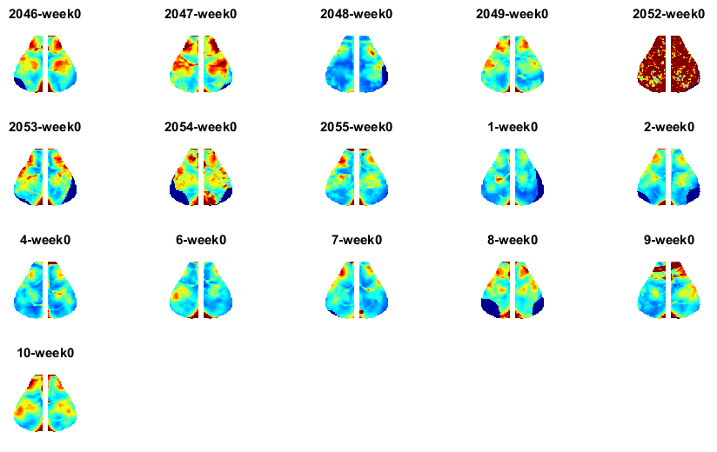
Week 0 Young Infraslow

Slide 4
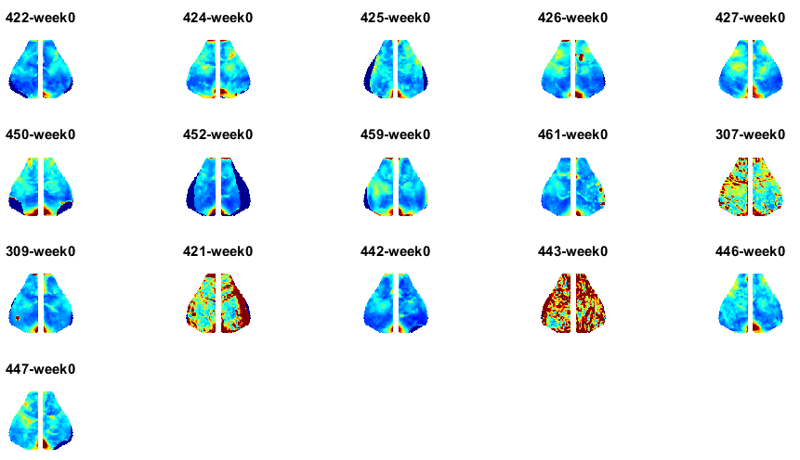

Week 0 Aged Infraslow
578

